Slide 1
SECURING PRIVACY AND PREVENTING SCAMS DURING ONLINE PURCHASES
BY
TEAM VULCAN

Slide 2
INTRODUCTION
Our aim is to find ways to prevent and reduce online purchase scams and their negative effects on our stakeholders. We also want to find ways to guarantee online privacy for them.
Our Primary Stakeholders are people who spend a considerable time shopping online in the working age group (16 - 60 years).
Our Secondary Stakeholders are Financial Institutions and e-commerce companies.
For data gathering purposes:
We interviewed one primary and two secondary stakeholders.
We also released two questionnaires, one for each type of stakeholder.

Slide 3
RESULTS AND FINDINGS
Interview with Victim and Primary Stakeholder Questionnaire
False Trust
Scammers build a connection with a victim
Enforces a sense of authority and legitimacy
Significance: Illustrates lack of privacy and social engineering executed
Unaware of rules and regulations
Users do not know right or wrong in this technological world
Many Institutions have different methods of interaction
Significance: Indicates the disconnect between institutions and users

Slide 4
RESULTS AND FINDINGS
Interview with Fraud Analyst and Secondary Stakeholder Questionnaire
Scam Waves
Large volume of similar scams are targeting people
Iterative (Fast Changing)
Significance: Explains why people fall for scams
Confusion and Targeting
initiates mass confusion among victims (among frequent online shoppers)
lack of awareness about current scams, leading to misplaced trust and ultimately victimization
Significance: Underlines a Pain Point

Slide 5

Solution 1 : NoSpam
An app which can detect spam calls, texts and emails.
The app collects user phone contacts with their permissions and stores them in a database. Sometimes nicknames contains relevant information, e.g. Celine Adidas Sales.
Users can also report incidents by submitting a form through our website to indicate a (number, email, or social media account) has scammed them.
With the big data, the app compiles and determines whether the contact number or email is affiliated with spam/fraud.
The app also provides most recent news on new or widespread scams.

Slide 6


PROS
CONS
Able to identify potential scammers/spammers by referencing past data
Easy to navigate (User-Friendly) and simple user interface
Educating customers on evolving scams, and
Providing detailed experience of scams for learning purposes.
Accuracy of spam/scam detection relies on user’s reports
High level of security is needed to maintain user’s privacy and safety
Managing and categorizing a growing database of scam reports can be resource-intensive.
The platform may require rigorous moderation to filter out inappropriate, offensive, or false reports.

Slide 7
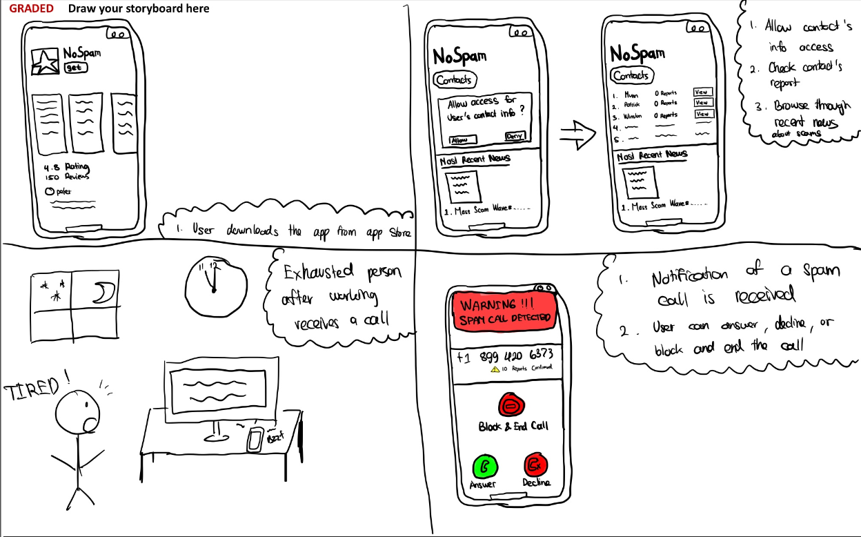
STORYBOARD

Slide 8

Solution 2 : AntiScam
Scams can be greatly reduced by raising awareness among people regarding how scams occur, the safeguards that are already available to them and learning from others’ experiences.
Our solution is a website containing blog posts or articles from users relating to their scam experience.
It will contain videos and podcasts related to topics like how scams occur, steps to protect yourself from scams, etc.
It will contain information about the scam policies and helplines of most major Canadian banks which people can look up to keep themselves updated.

Slide 9
PROS
CONS
Creating a community platform where people can learn from others.
Access to scam policies and helplines from major Canadian Banks.
Serve as a valuable educational resource.
No sure way of preventing the scam from happening.
Running and maintaining a website with blogs, articles, videos can be resource-intensive as it needs moderation.
Hard to reach less tech-savvy audience, thus leaving out a big portion of the population at risk to scams.

Slide 10
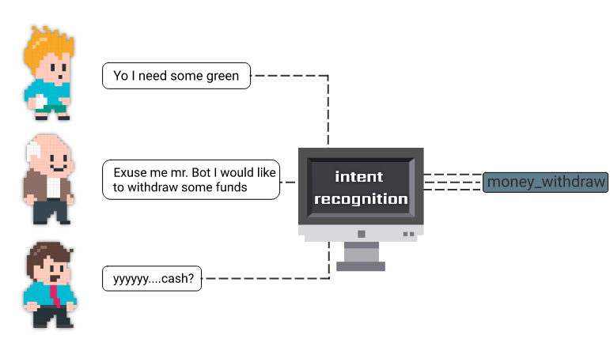
Solution 3 : Intent Detection
There are certain patterns common across all scam texts and emails. E.g.: misleading links, specific language usage, asking the user for specific data, etc.
Scam and phishing emails can be identified and flagged using LLMs trained to identify malicious intent.
Prevents scams on multiple platforms - with browser plugin for emails and phone app to address texts and phone calls.

Slide 11
PROS
CONS
Able to identify and warn users about scams regardless of whether scammer’s phone number or email address is tracked in databases.
Plenty of scam email data sets available online for training NLP Model.
Can be used to combat phone call scams in real-time with speech to text and LLM classification.
Privacy is a big concern. People may not want their personal phone calls and emails recorded and processed non-locally.
Not 100% effective. Natural language models may produce false positives and false negatives. Needs good training.
Sourcing of training data for phone calls would prove to be challenging and labour intensive.

Slide 12
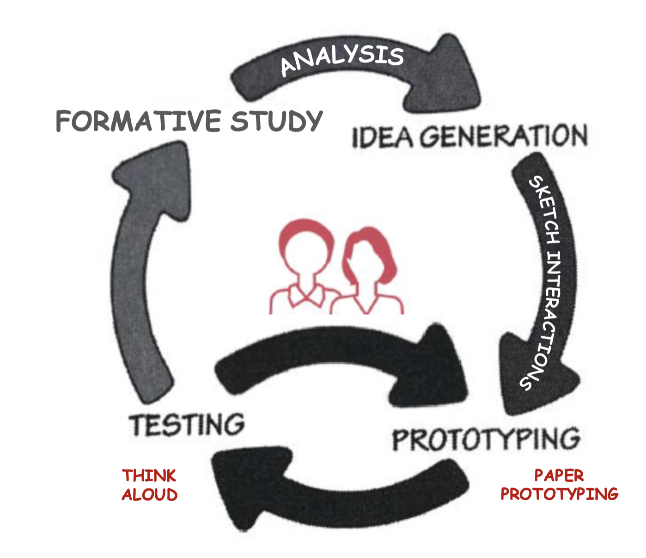
NEXT STEPS
Generating and Reconfiguring Solutions
Branch out and flesh out more solutions
Working around our current limitations and find solutions that can tackle them better
Creating storyboards for various scenarios and context
To help us determine which solution is best, we are going to create storyboards for different scenarios and contexts
Creating our First Prototype and Testing it
After tackling our limitations, we will start creating our first prototype for our chosen solution and thoroughly test it

Slide 13

QUESTIONS
Privacy continues to be an important concern and limitation we still have when generating solutions. Hence, we are reaching out to you to know how comfortable you would be with a built-in extension or app that can access your phone call log and email messages?
We are taking into account different scam scenarios that arise when shopping online. In order to create storyboards, we need your help determining the most common and important ones. What are the scam scenarios for online shopping that you feel we should focus on the most?

